Slide 1
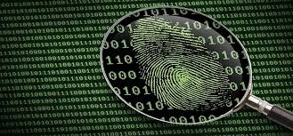
2008 Nitroba University Harassment Scenario
Final Project
CS 362
Professor Mohaisen
Created by: Isaac Abraham, Mirza Baig, Sarah Benavides , Ruzzle Cablayan, and Farhan Zaman

Slide 2
Case Overview
The case we are working on occurred in the summer of 2008 at Nitroba University. The IT department received an email from a chemistry teacher named Lily Tuckrige. This email stated Professor Tuckrige was receiving harassing emails from someone thought to be enrolled in her chemistry class. That student used an IP address coming from a Nitroba University dorm room (140.247.52.34) when sending the emails. In the attempt to track down the offender, the university placed a network sniffer on the ethernet port allowing all the packets to be logged.

Slide 3
Objectives
The main goal of this project is to determine who out of the chemistry 109 students, if any, are responsible for the attack. For this specific case, our group used a pcap file including all logged packets, as well as, a pdf file that walks through the problem.

Slide 4
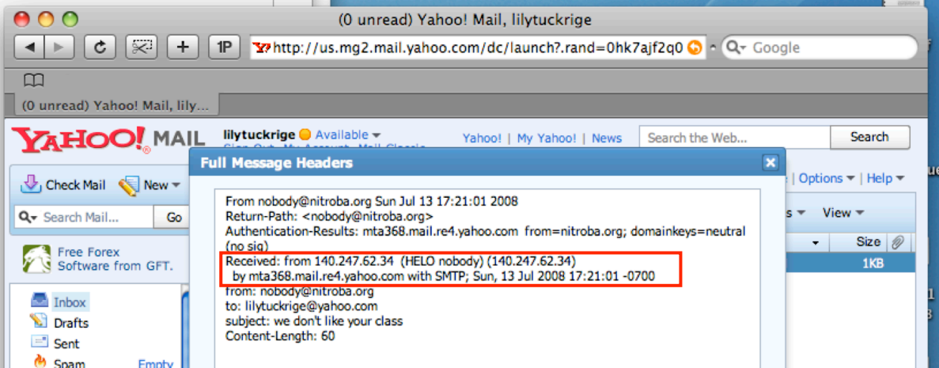
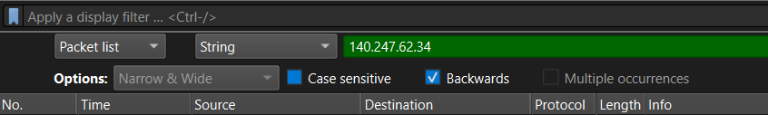
Finding the IP address (Wireshark)
Finding out that the email header contained the IP 140.247.62.34. This pointed us toward a dorm room where 3 students lived in on campus
Opening the Nitroba pcap (packet capture) file in Wireshark we use CTRL + F to search specific packet that contain the public ip 140.247.62.34

Slide 5
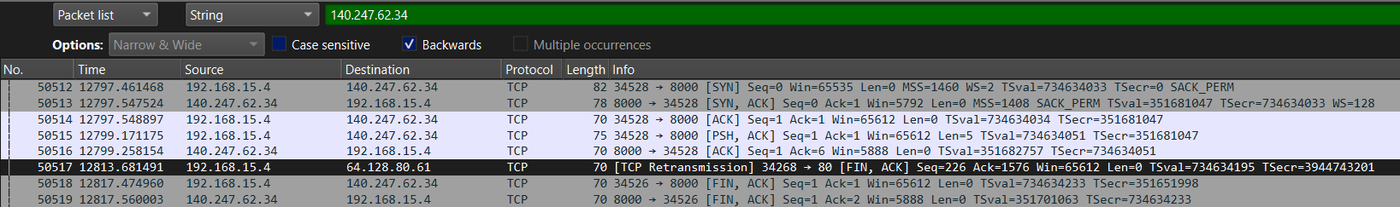
Finding the IP address (Wireshark)
Doing this we are able to find out that the dorm IP maps to a common internal IP address 192.168.15.4 through the search.
We then filter the packets using frame contains “tuckrige” and this shows us the two threatening emails sent to tuckrige from that same local ip address

Slide 6
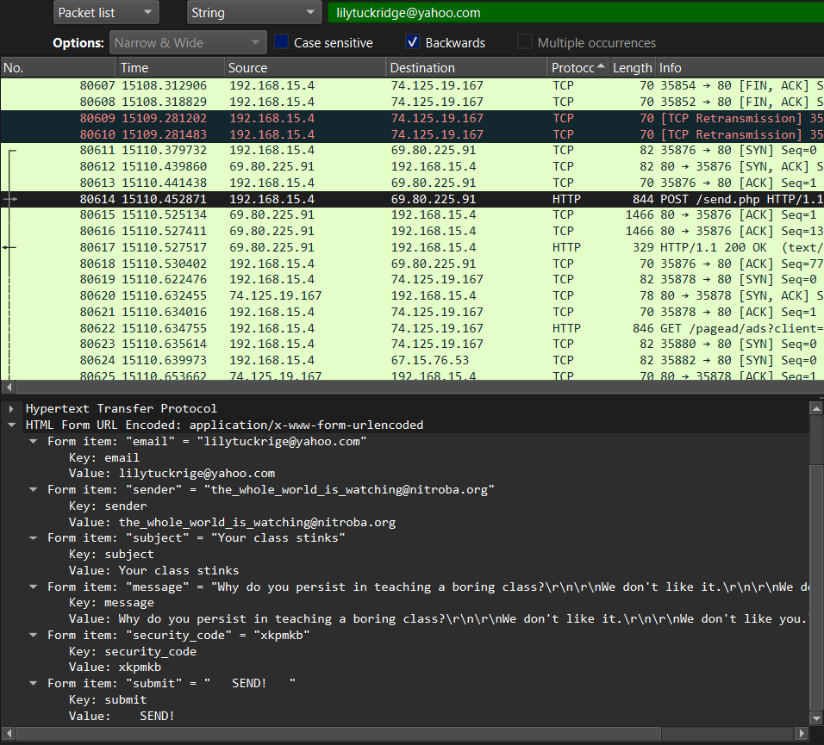
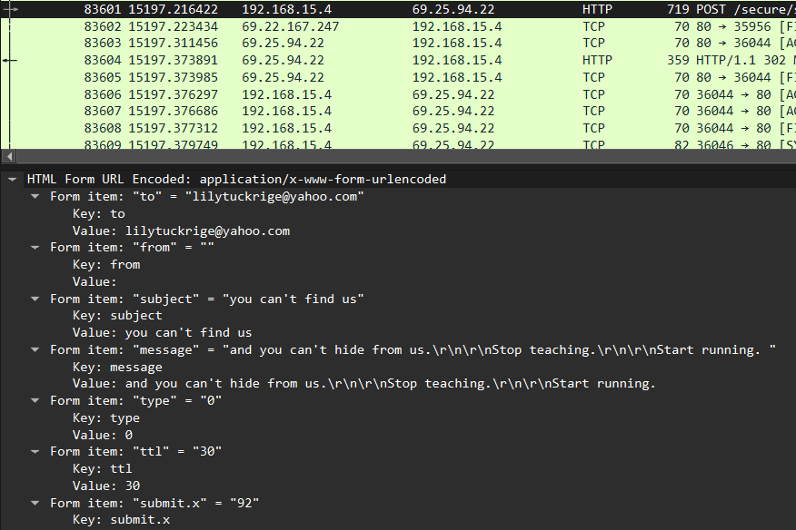
Finding the IP address (Wireshark)

Slide 7
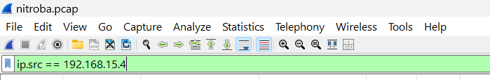
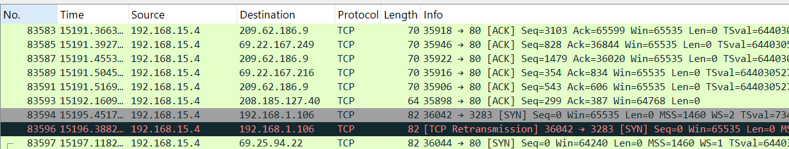
Following IP Address/Collecting More Data
After locating the IP address 192.168.15.4, Wireshark was used to filter that IP address (follow the suspect)
Typed ip.src == 192.168.15.4 into the filter box at the very top of Wireshark
Once applying this filter, you see traffic from the suspect ONLY

Slide 8
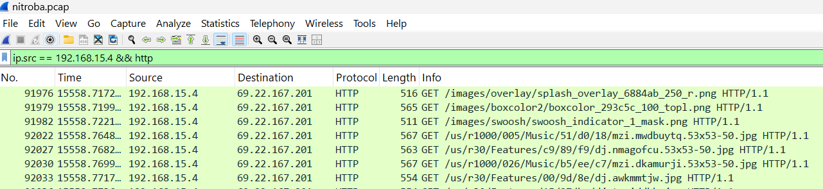
Following IP Address/Collecting More Data
Begin searching for communication between web browser and web server using a second filter http (Hypertext Transfer Protocol)
Input ip.src == 192.168.15.4 && http to apply both filters
After using both filters AND searching for a packet that contains the keyword “yahoo” within the data... we found two names

Slide 9
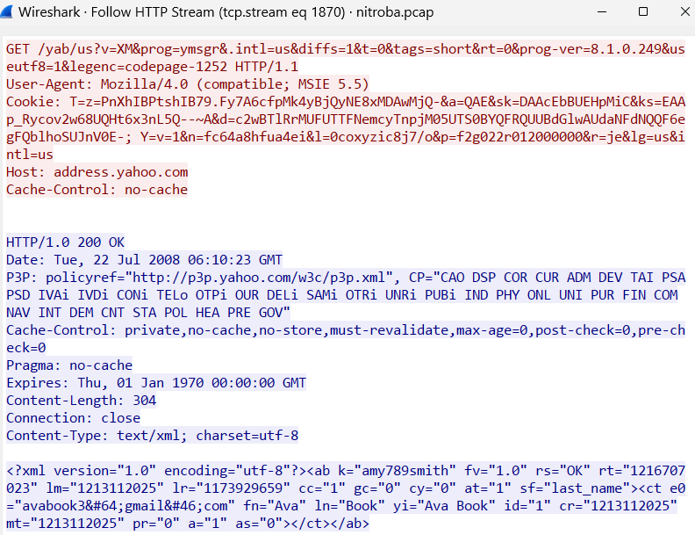
Following IP Address/Collecting More Data
The names Amy Smith and Ava Book were found
Synchronization of someone’s yahoo address book
To check if either of these students are linked to the suspect, we will search for Amy and Ava’s emails: amy789smith and avabook3
Didn’t find any other packets with their names

Slide 10
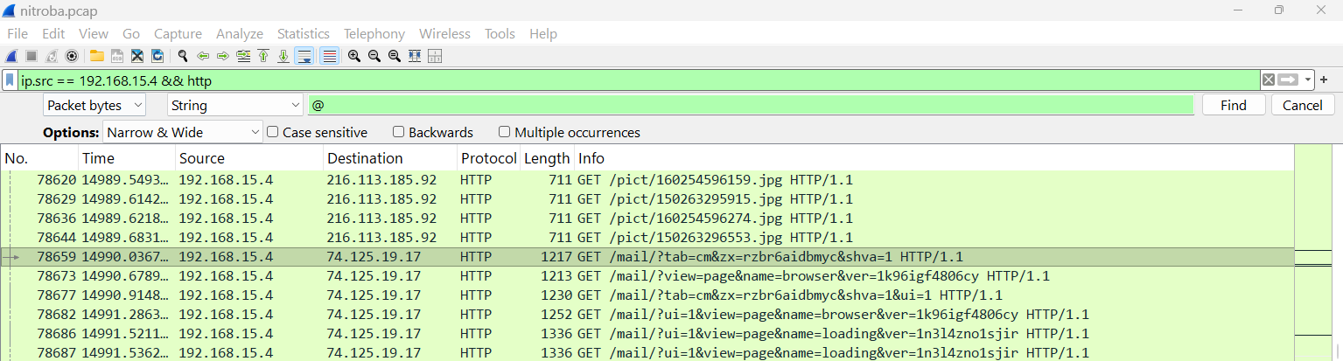
Following IP Address/Collecting More Data
The search was then switched to using the symbol @
Within the highlighted packet, an email address and another name was found

Slide 11
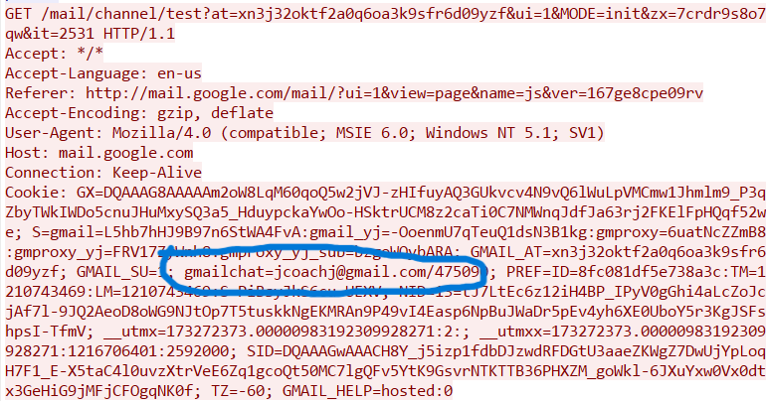
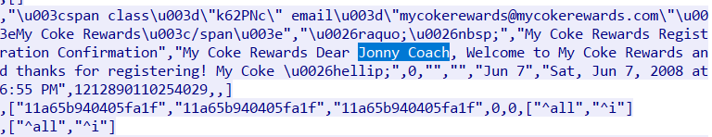
Following IP Address/Collecting More Data
The email jcoachj@gmail.com and the name Jonny Coach were found within this packet
To begin proving Johnny Coach was responsible for the harassing emails, look at the user-agents

Slide 12




Following IP Address/Collecting More Data
The user-agent from the harassing email packet and the packet in which we found the email were the same → proves the same browser and operating system used
Harassing email packet:
jcoachj@gmail.com packet:
The next information to collect to prove Johnny is guilty, comparing MAC addresses of the packets above

Slide 13



Following IP Address/Collecting More Data
Last pieces of information to prove that Johnny Coach was the suspect who sent the harassing emails to the professor are the timestamps
Difference in time between the login to the gmail account and one of the harassing emails was two minutes
Difference in time between one harassing email to another was one minute and 27 seconds

Slide 14
Primary tool: Wireshark
Used for network traffic analysis and packet inspection
Helped identify suspicious communications and source activity
Allowed us to trace IP addresses involved in harassment
Explanation/Analysis

Slide 15
What is Wireshark?
Wireshark is a network protocol analyzer
Captures and displays network traffic in real time or from saved files
Allows investigators to:
View individual data packets
Filter traffic by IP address or protocol
Reconstruct conversations from captured data

Slide 16
How We Used Wireshark in This Case
Loaded the provided PCAP file from the Nitroba University scenario
Applied filters to narrow down relevant traffic:
http to view web activity
ip.addr == [192.168.15.4 ] to track specific users
tcp.stream to rebuild conversations
Identified harassment-related messages and their origin

Slide 17
Analysis Process (Step-by-Step)
Opened the network capture file in Wireshark
Filtered traffic to isolate suspicious activity
Followed TCP streams to reconstruct conversations
Identified repeated communication from the same IP address
Extracted key metadata (IP addresses, timestamps, protocols)
Linked findings to case objectives

Slide 18
Additional Tools & Techniques
IP lookup tools to trace geographic location and ISP
Packet inspection to detect hidden or encoded data
Email header analysis (if applicable to scenario)
Timeline reconstruction using timestamps from packets

Slide 19
Key Takeaways from Our Methodology
Network forensics relies on analyzing raw packet data
Filtering is essential to isolate relevant evidence
IP addresses and timestamps help build digital timelines
Wireshark allows reconstruction of real user activity from traffic data

Slide 20
References
https://daniel-weninger.com/blog/forensics-2-nitroba/
https://digitalcorpora.s3.amazonaws.com/corpora/scenarios/2008-nitroba/slides.pdf

